Slide 1

Tuberculosis in Nepal
Defeating the world’s most deadly infectious disease in Nepal
Is a first step to beating TB back worldwide
And you can help
So little money does so much good to avert so much human suffering

Slide 2

This Does not Need to Happen!!!!!!
TB almost invisibly rare in wealthier countries
TB concentrated in lower income countries in South Asia, Africa, Indonesia and Latin America
Treatment of active TB is prohibitively expensive public health solution for poor countries
Nepal (population 27 MM):
16,000 deaths per year
68,000 active cases
( 1.3 Million deaths last year from almost 10 million active TB cases)

Slide 3

New Best Seller argues that TB is not primarily caused by bacteria but by human choices
We hope that this pilot program will lead to saving millions of lives and hospitalizations worldwide over the years ahead

Slide 4
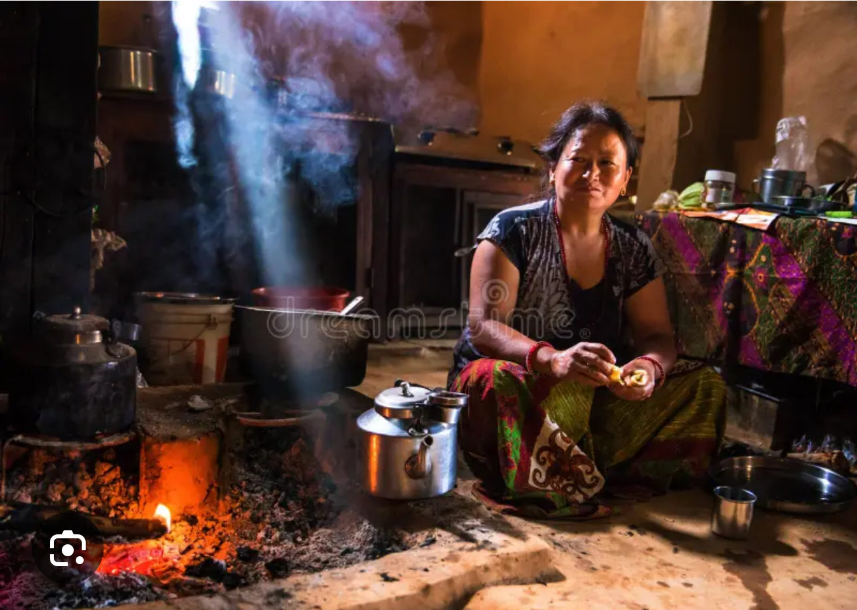
The challenges:
No vaccine available or likely soon
Treating Active TB effectively prohibitively expensive for poor countries
The opportunity
90% of TB is latent and symptom free
Latent TB is inexpensive to treat
Widespread in Nepal and high TB areas
The concept:
Contact trace those with active TB.
Test for latent (symptom free) TB
Treat (inexpensively) when identified (90% effective)
Prevent active TB
Overtime latent TB rates fall community wide, costs come down, suffering

Slide 5

A Proven Approach
TB virtually wiped out in Inuit communities in Alaska with this approach
High interest in testing and solid treatment compliance when a close family member or friend dangerously ill
Needs proof of concept in developing world setting
Nepal is the ideal venue
High incidence
Low HIV comorbitity
Decent community health network

Slide 6
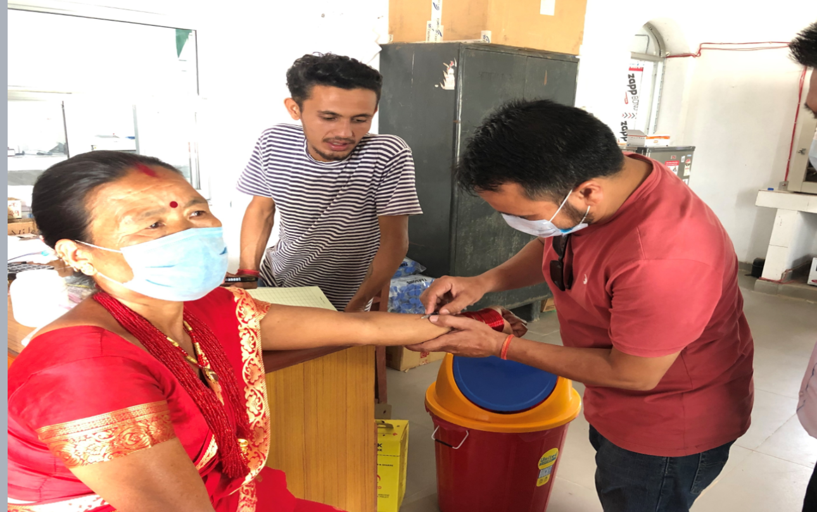
The Plan
Roll out in 4 districts in Nepal over 3 years
Cost: Less than $2 million
Use data to raise $40 million to roll out across Nepal and raise funds for other high incidence regions
Raise awareness to lead to similar programs across high TB regions

Slide 7
Cost Effectiveness of Pilot Program
Target:
150-250 lives saved
1000-1800 active cases prevented
These hospitalizations and treatments would cost $_____ in Nepal
If factored in, the net cost of the $ 2 million program about $_____
Cost per life saved + hospitalization prevented
about $1000
About $_________ net of prevented treatment costs of active TB
All this for $2 million
Hard to avert so much suffering anywhere for so little

Slide 8
Effective Proven team and implementation plan
Detailed CV’s, Budgets, etc. available
Dr. Buddha Basnyat
Nepali (Kathmandu)Doctor, US trained. Specialized in infectious diseases (TB, typhoid). Published in Lancet, BMJ,NEMJ, numerous peer reviewed articles. Principal investigator for numerous studies. Trustee for Royal Society of Tropical Medicine.
Dr. Max Caws, PhD,
Senior researcher in TB at Liverpool School of Tropical Medicine. Principal investigator for IMPACT TB consortium to scal up and develop evidence to inform policy decisions for national TB programs in Vietnam and Nepal. Published over 100 peer reviewed articles.
Detailed budget available for health staff, community supervision, testing, treatment, administration, etc.

Slide 9

Please Help
Make tax deductible donations to
(insert detailed information)
For more information, contact:

